Slide 1
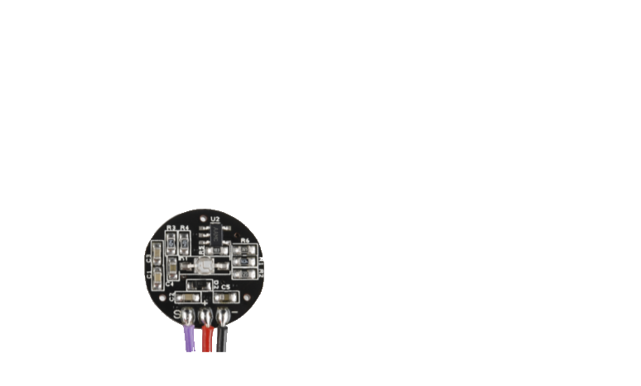


Slide 2
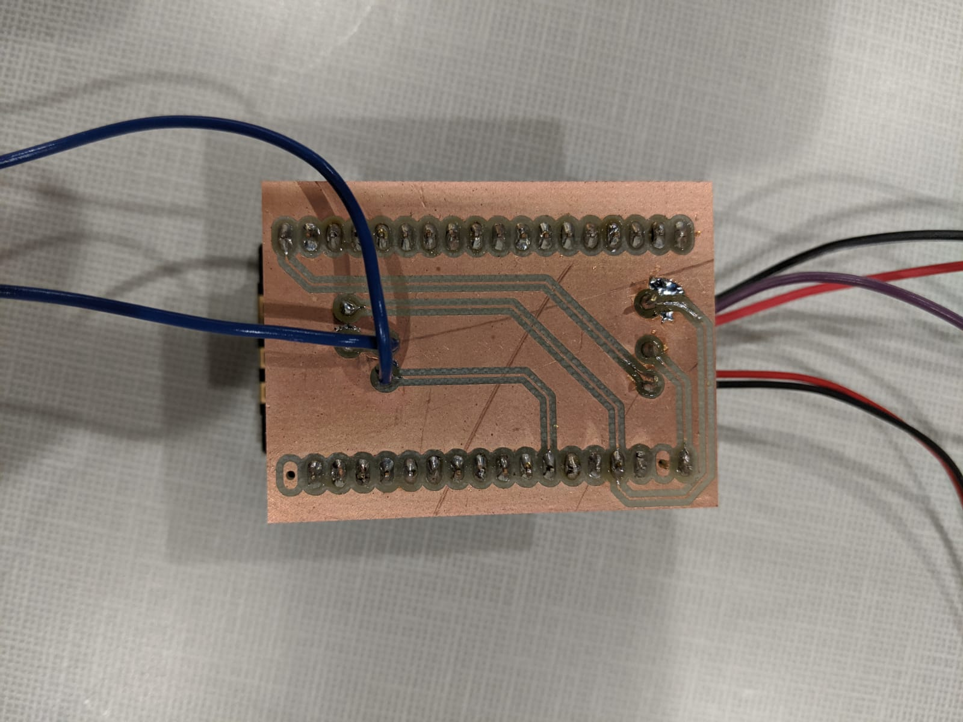
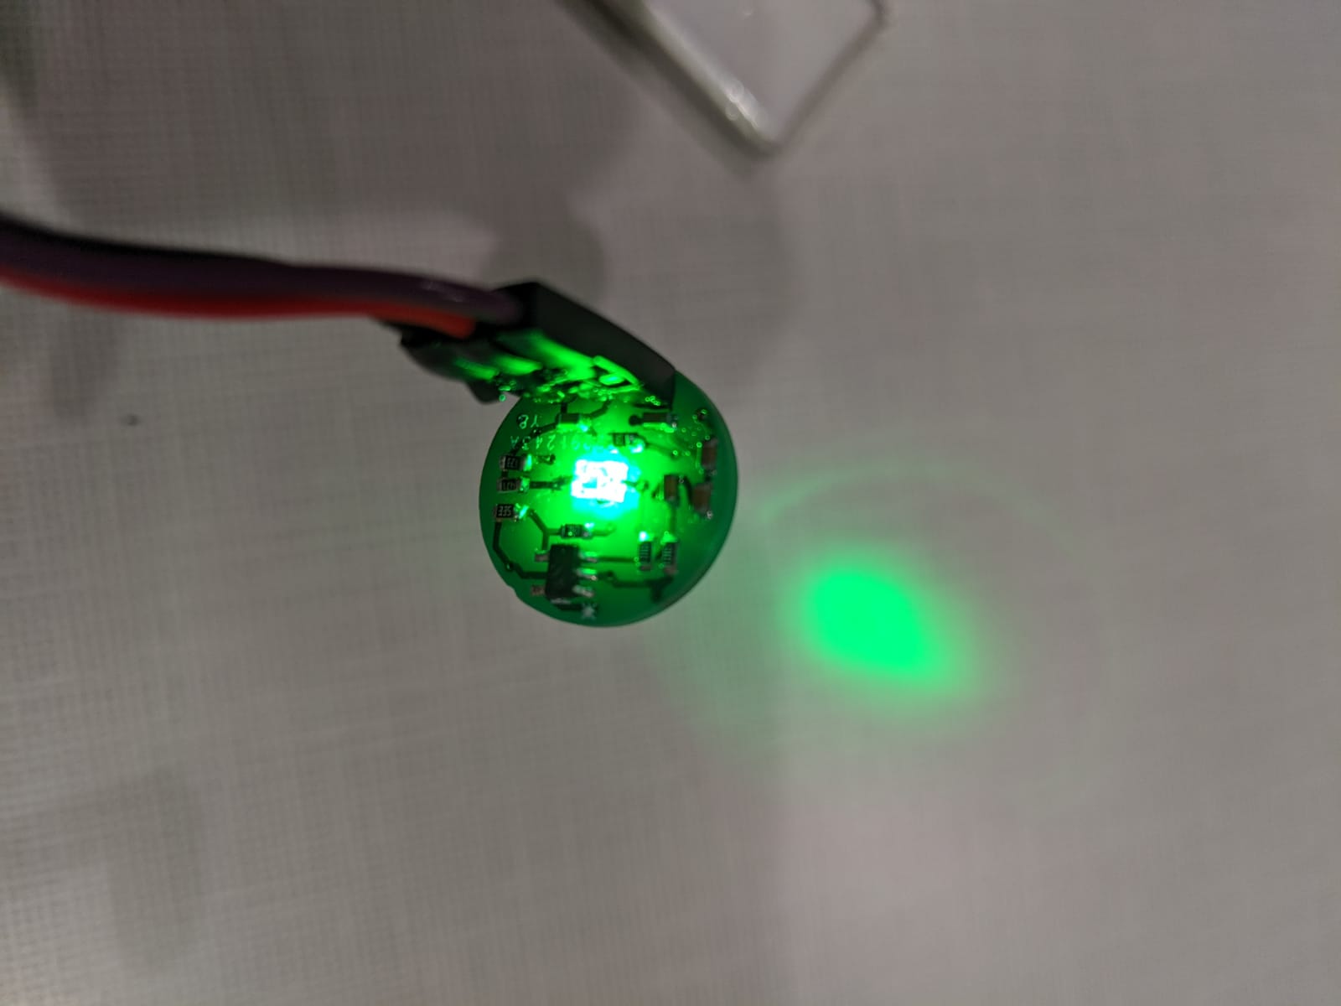
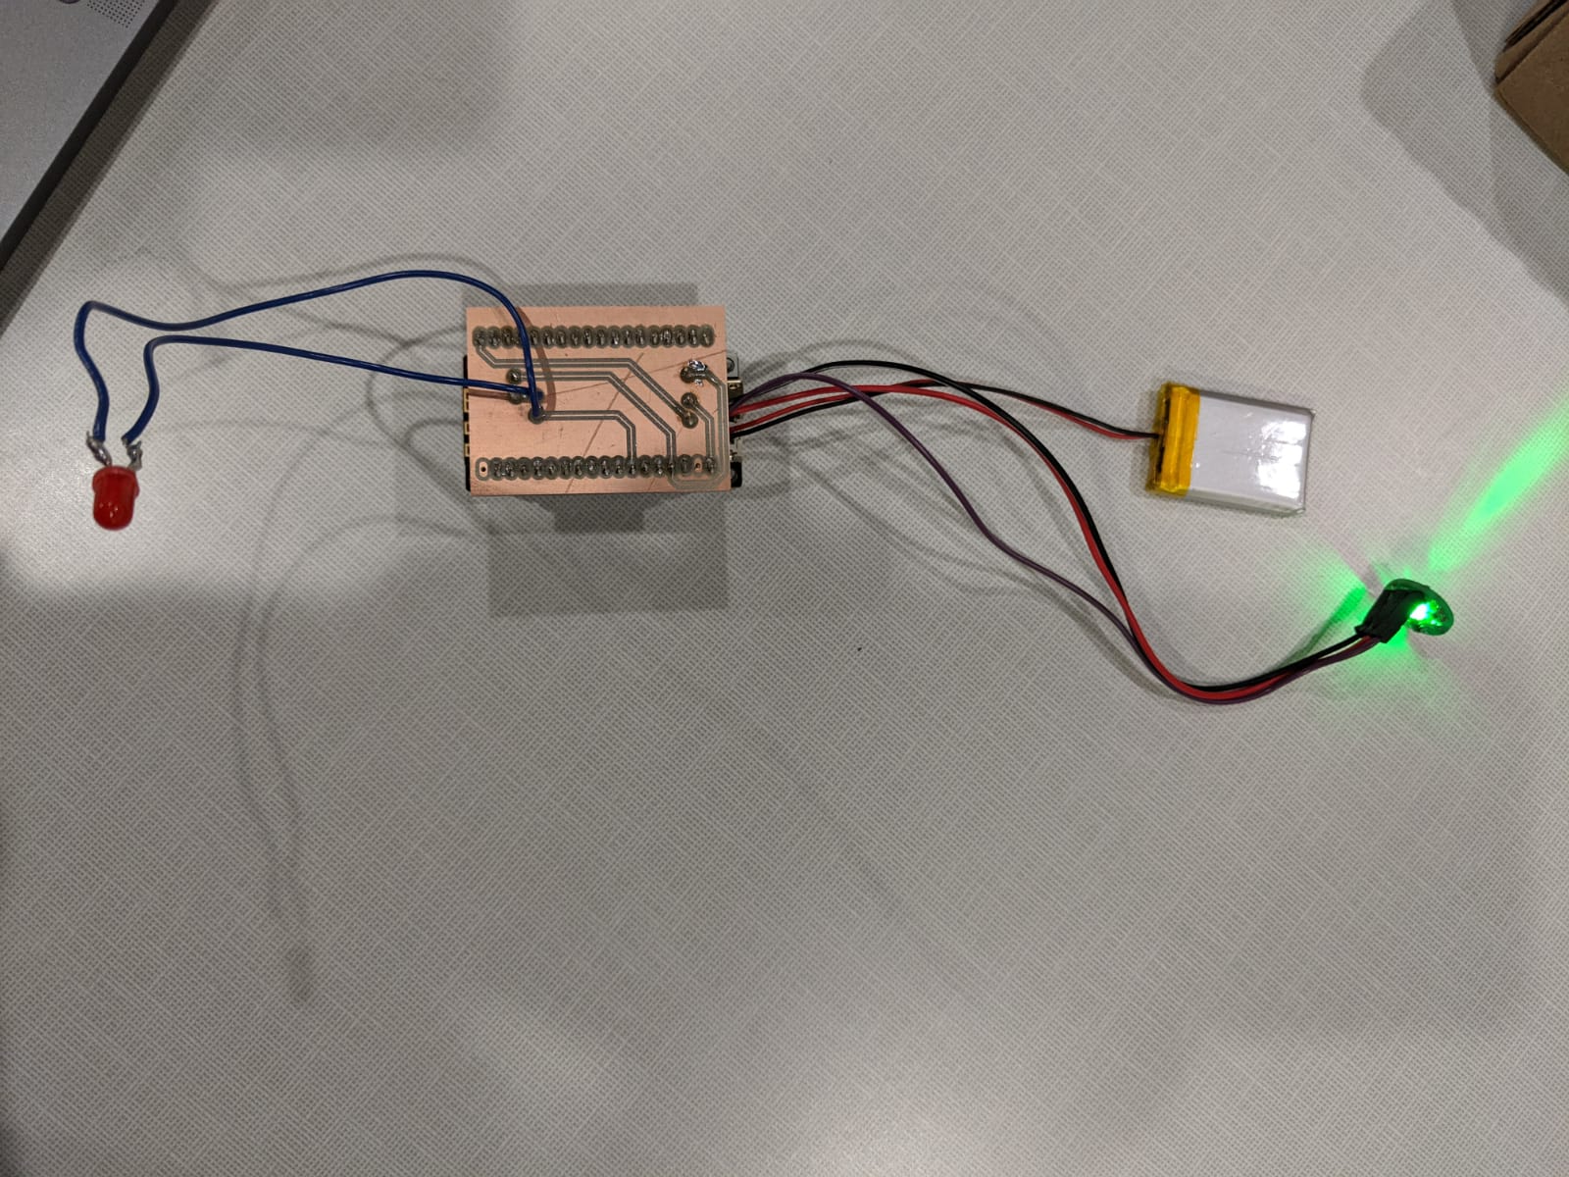
Prototyping
Board
PPG
Device

Slide 3
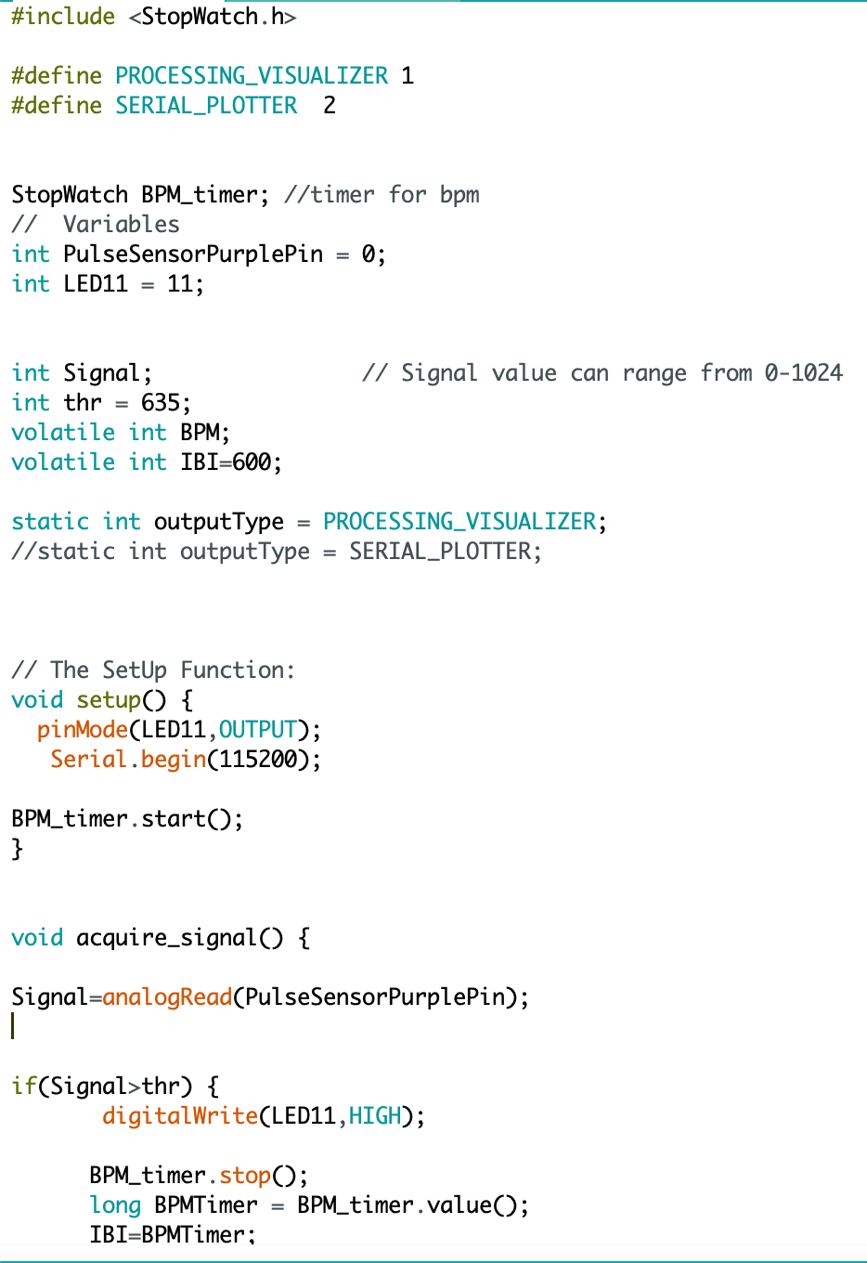
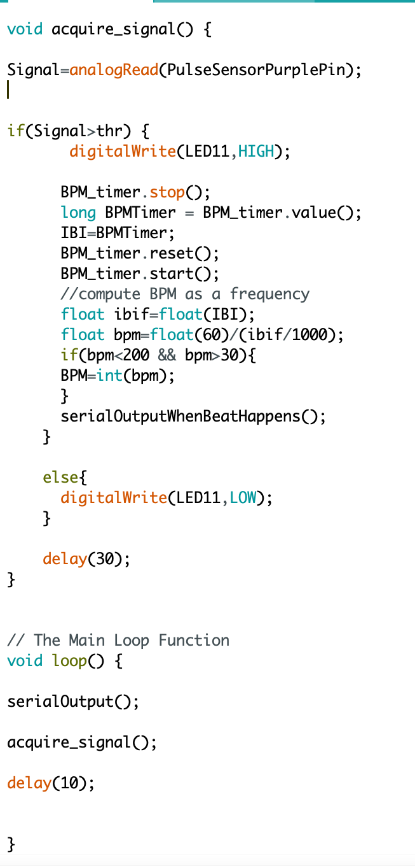

Signal Acquisition
Receive Pulse signal from the device via Arduino
Recognize heart beat
Switch on Led
Send to Processing

Slide 4
Poincare Plot and Main interface
To show the heartrate variability:

Slide 5
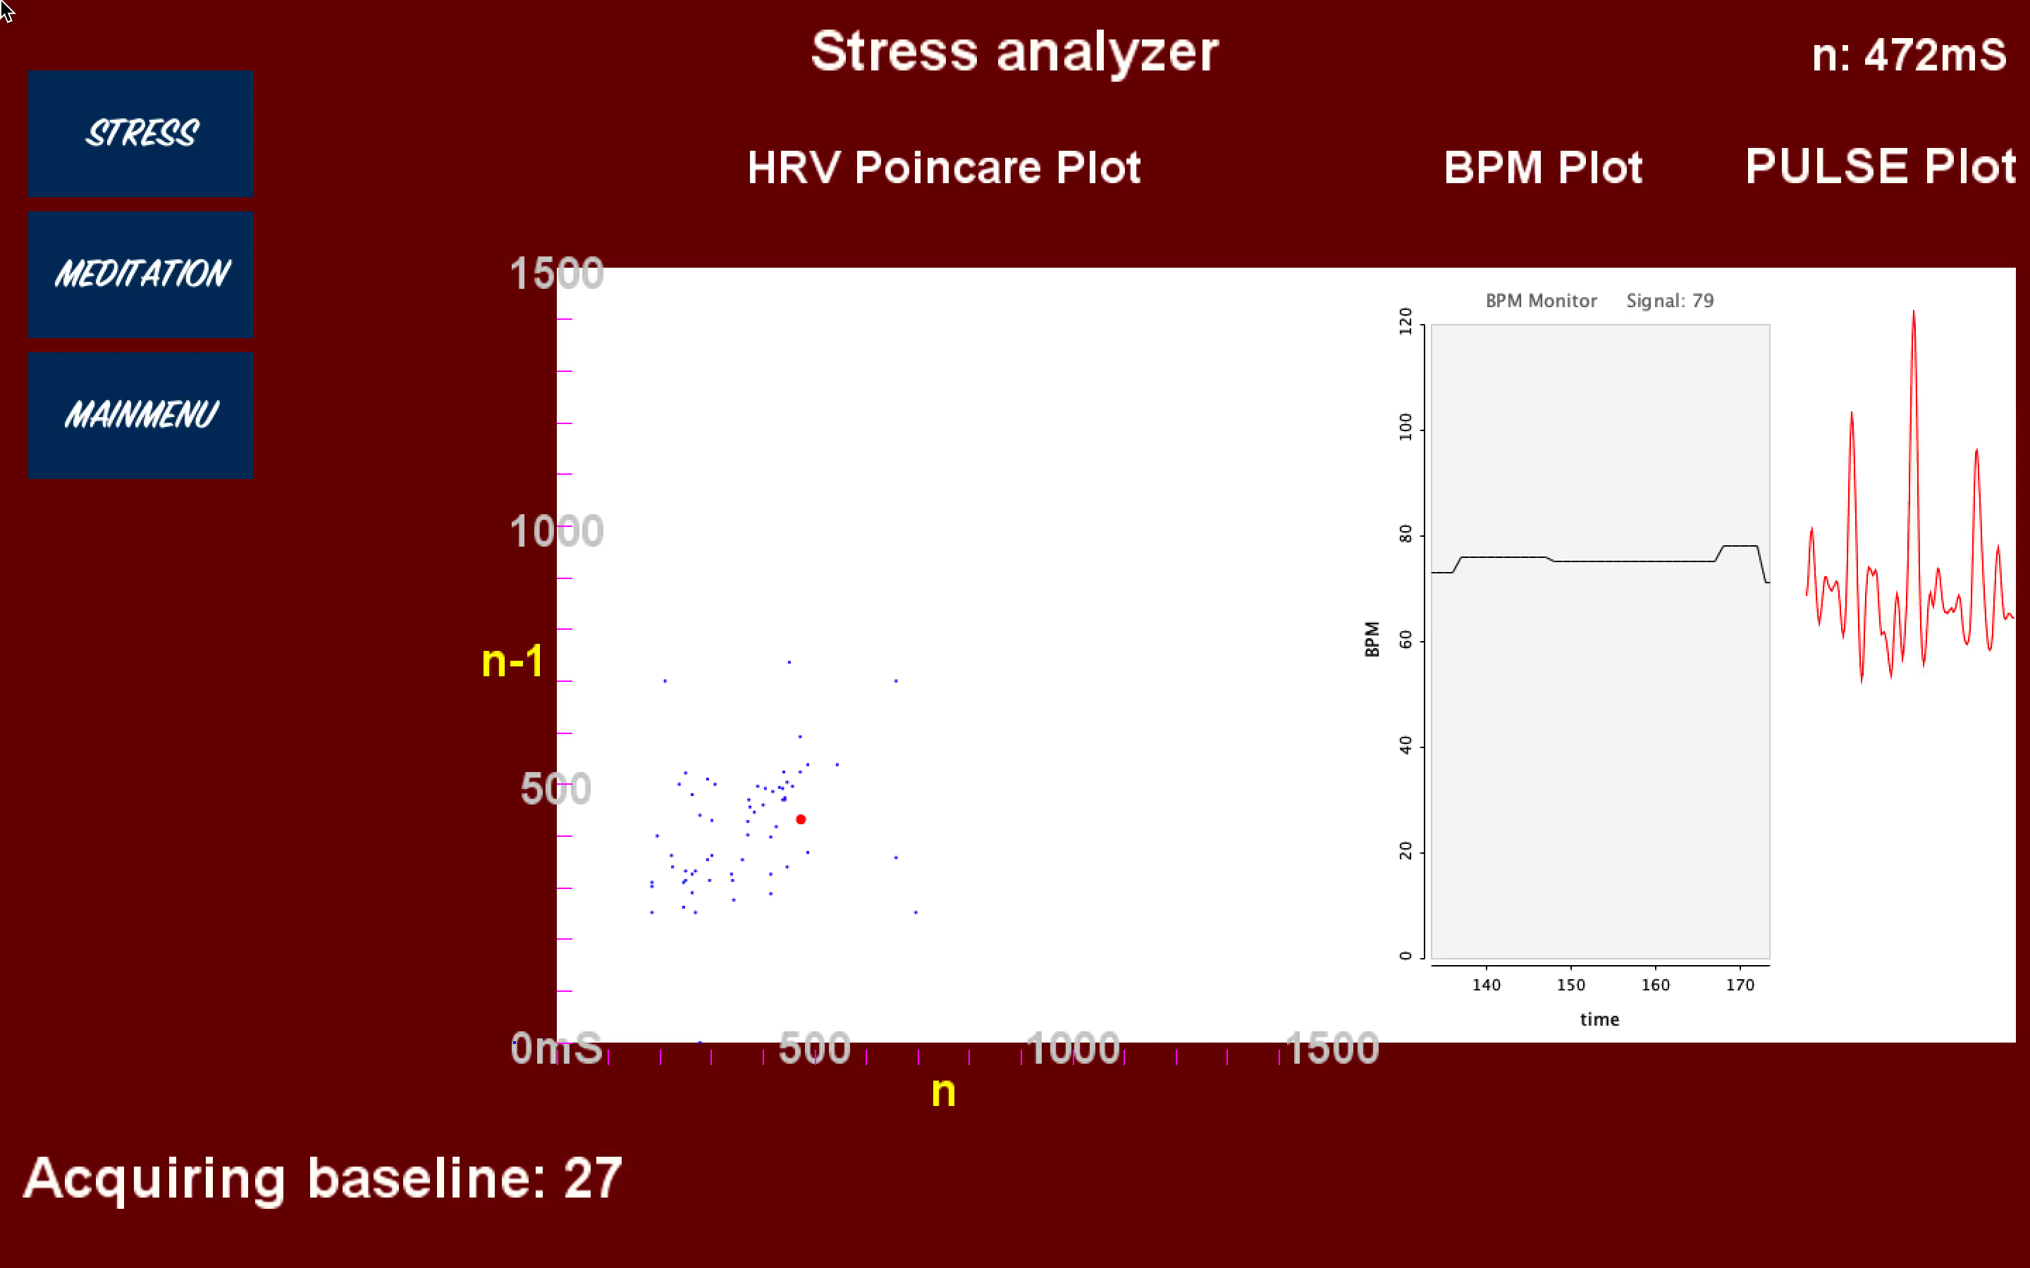
Stress Analyzer
Acquire baseline for 30 seconds
Check if the baseline is typical of a stressed individual
Play a song to relax the person whenever she’s stressed

Slide 6
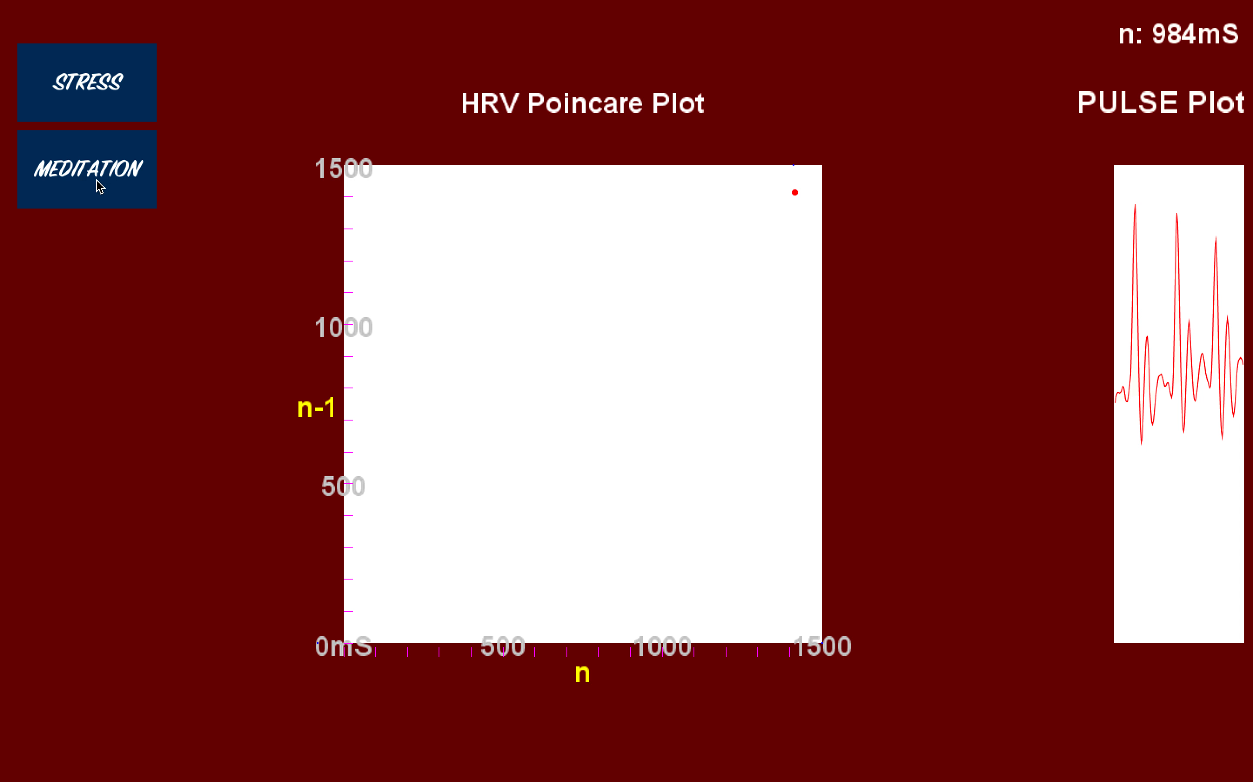
Meditation analyzer
Acquire baseline for 30 seconds
Check if the person heart beat is stable under a threshold
Remind her to relax if it is not under a threshold for 3 consecutive heart beats

Slide 7
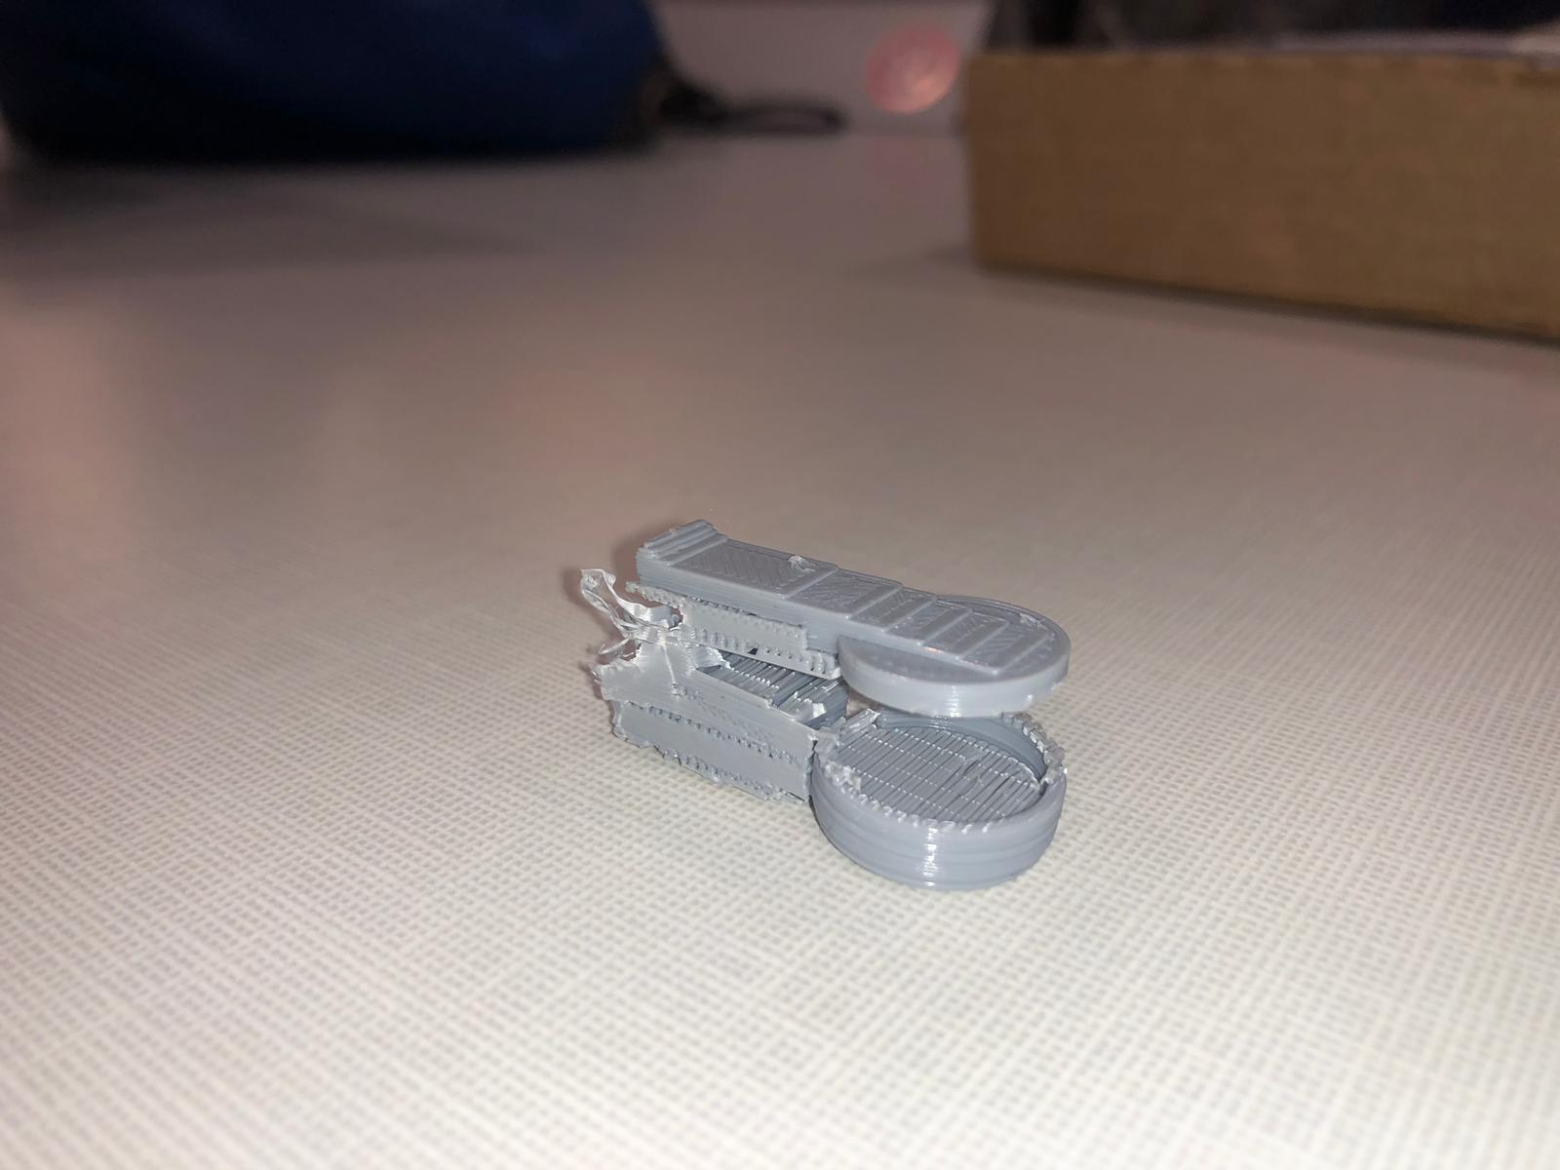
Final Device
Housing of the device

